Slide 1
Econ 106 Data Analysis in Economics
Fall 2024
Lecture 2
Based on: http://www.datacarpentry.org/R-ecology-lesson/
Notes:
Hi, and welcome R basics. Today we’re going to be discussing how to use the R programming language and the RStudio interface to read and subset tabular data.

Slide 2
Reminders
Poll Everywhere is practice this week, next week counts towards your grade
Please remember to log in at the beginning of each lecture:
PollEv.com/vsovero

Slide 3
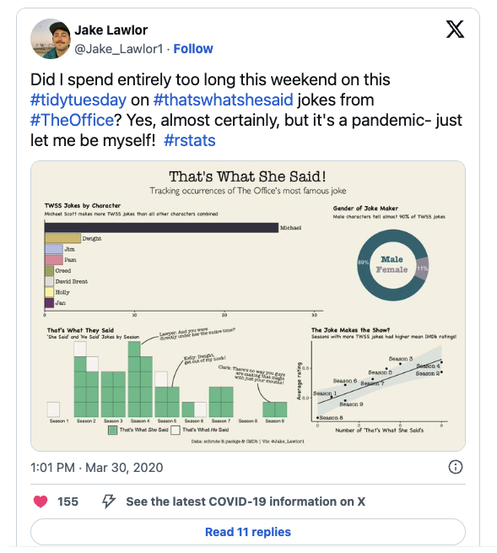
#tidytuesday
weekly data challenge using R
every Tuesday a new challenge is posted here
The data used in this example can be found here
you can browse the results on social media (#tidytuesday)
Good source of inspiration for your projects

Slide 4
Outline
Vectors
Packages
Data Frames
Notes:
In brief, we’ll
1. Introduce the R programming language and the RStudio interface
2. Discuss how operators and functions work
3. Investigate the structure of data frames

Slide 5
Objects
weight_kg <- 55
Objects store data(information)
We use the assignment operator <- to save values into objects
Notes:
To save the results of mathematical computations, we use the assignment operator, which is symbolized by the left carat and a dash with no spaces in between
This operator assigns a value to a variable.
For example, we can assign the value 55 to the variable weight_kg.
The values in these variables can be overwritten by a second assignment operation.
Let’s look at operators in action.
Demo: Operators
# R can do math!
3+5 #Prints 8 to the console
12/7 #prints 1.714286 to the console
# The assignment operator (<-): storing values in variables
weight_kg <- 55 # doesn't print anything
(weight_kg <- 55) # but putting parentheses around the call prints the value of
weight_kg # and so does typing the name of the object
##### Example: unit conversions
weight_kg*2.2 #Output the weight in pounds to the console
weight_kg<-57.5 #Values of variables can be changed
weight_lb<-weight_kg*2.2 #Results of calculations can be assigned to new variables

Slide 6
Objects: Not Just for Storing Numbers
Basic Data types:
Character
Numeric
 | type
x <- 32 | numeric
y <- "hi" | character

Slide 7
Data structures
So far, we’ve been dealing with rather simple data:
one value stored in one object
R has more complex data structures that make working with more complex data easier:
Vectors: multiple values of the same type.
Data frame: multiple vectors of the same length grouped as columns.
Notes:
So far, we’ve been dealing with rather simple data: one value stored in one object. But R has more complex data structures that make working with more complex data easier. The ones we’re going to be talking about today are vectors and data frames.
Let’s take a closer look at vectors first.

Slide 8
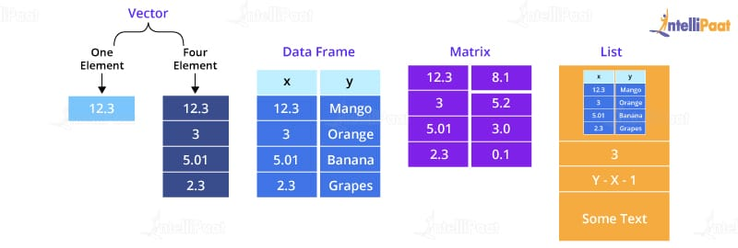
Vectors: Objects with Multiple Values
R can store multiple values of the same type in a data type called a vector.
An object with a single element is actually a vector (length 1):
x <- 12.3
Notes:
So far, we’ve been dealing with rather simple data: one value stored in one object. But R has more complex data structures that make working with more complex data easier. The ones we’re going to be talking about today are vectors and data frames.
Let’s take a closer look at vectors first.

Slide 9
Creating Objects With Multiple Values
Just like other objects, vectors are assigned values using the assignment operator
To assign multiple values to the object, we use the combine function c()
Each value is separated by a comma
#Example: a vector of ages
age<-c(30, 40, 25, 22)
PollEv.com/vsovero
Notes:
So far, we’ve been working with individual data points stored in objects. However, R can store multiple values of the same type in a data type called a vector.
Just like other objects, they are assigned values using the assignment operator
To assign multiple values to the object, we use the c() or concatenate function
Each value is separated by a comma

Slide 10
Creating Objects With Multiple Values
Combine function c() :
Input: values separated by commas
Output: a vector object
All the same data type
#Example: a vector of ages
age<-c(30, 40, 25, 22)
Notes:
So far, we’ve been working with individual data points stored in objects. However, R can store multiple values of the same type in a data type called a vector.
Just like other objects, they are assigned values using the assignment operator
To assign multiple values to the object, we use the c() or concatenate function
Each value is separated by a comma

Slide 11
Creating Objects With Multiple Values
for character vectors, use straight quotes around the values
Single or double is fine
#Example: a character vector of favorite animals
animals<-c("cat", "dog", "dog", "dog")
#This also works
animals<-c('cat', 'dog', 'dog', 'dog')
Notes:
So far, we’ve been working with individual data points stored in objects. However, R can store multiple values of the same type in a data type called a vector.
Just like other objects, they are assigned values using the assignment operator
To assign multiple values to the object, we use the c() or concatenate function
Each value is separated by a comma

Slide 12
Functions for inspecting vector type
R automatically records what type of data is stored in an object
Helpful functions:
class()
typeof()
 | class( ) | typeof( )
x <- 32 | numeric | double
y <- "hi" | character | character
Notes:
So how do you tell definitively what R interprets your data as? R has functions that gives you this information: class() and typeof(). They all work slightly differently, but they all give you a level of detail about what type of data is stored in an object. We’ll primarily be using class() in this lesson, but it’s good to know the others exist
Demo:
#Assign a number value to an object
x<-32
class(x) #numeric
#Assign text value to an object
y<-"hi"
class(y) #character
#Assign logical value to an object
z<- TRUE
class(z) #logical

Slide 13
Class Coercion
A vector can't mix and match types, so R will choose a type that applies to most values (class coercion)
Sometimes this choice isn’t obvious (usually character)
Use class() to see what R picked
#What types are these vectors?
first_vector<- c(1, 2, 3, "a" )
second_vector <- c(1, 2, 3, "4" )

Slide 14
Summarizing Numeric Vectors
#A vector of ages
age<-c(30, 40, 25, 22)
#What happens when you try to compute the mean?
mean(age)
Numeric vector: you can compute the mean

Slide 15
Helpful functions for summarizing numeric vectors
mean()
median()
max()
min()
sd()
summary()

Slide 16
Summarizing character vectors?
#a character vector of favorite animals
animals<-c("cat", "dog", "dog", "dog")
#What happens when you try to compute the mean?
mean(animals)
character vector: you will get warning message if you try to compute the mean, median, min, max ()
It will return a value of NA (how R records missing values)
PollEv.com/vsovero

Slide 17
Factors
#a character vector of favorite animals
animals<-c("cat", "dog", "dog", "dog")
#let’s convert animals into a factor variable
animals_factor<-factor(animals)
We need to convert the animal vector into a factor, which is R’s way of storing categorical data (variables with a finite set of categories)
we use the factor() function to create a factor variable from the animals vector

Slide 18
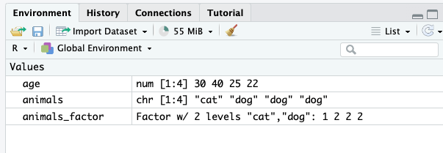
Factors
You can already see that there’s more useful information when animals is stored as a factor instead of a character vector

Slide 19
Summarizing Factors
We can now calculate summary statistics more appropriate for categorical data
Input | Output
levels(animals_factor) | "cat" "dog"
nlevels(animals_factor) | 2
summary(animals_factor) | cat dog 1 3

Slide 20
Data structures: Vectors to Data Frames
vector
vector
data frame
When we have multiple pieces of information from the same people, it’s more useful to have the information stored as a single table vs individual vectors
30
40
25
22
cat
dog
dog
dog
30 | cat
40 | dog
25 | dog
22 | dog
Notes:
So far, we’ve been dealing with rather simple data: one value stored in one object. But R has more complex data structures that make working with more complex data easier. The ones we’re going to be talking about today are vectors and data frames.
Let’s take a closer look at vectors first.

Slide 21
Data structures: Vectors to Data Frames
This will allow us to do thing such as:
calculate average age for cat people
calculate average age for dog people
We’ll learn how to do these things next week
data frame
30 | cat
40 | dog
25 | dog
22 | dog
Notes:
So far, we’ve been dealing with rather simple data: one value stored in one object. But R has more complex data structures that make working with more complex data easier. The ones we’re going to be talking about today are vectors and data frames.
Let’s take a closer look at vectors first.

Slide 22
Data structures: Vectors to Data Frames
Vectors are the building blocks of Data Frames
Notes:
So far, we’ve been dealing with rather simple data: one value stored in one object. But R has more complex data structures that make working with more complex data easier. The ones we’re going to be talking about today are vectors and data frames.
Let’s take a closer look at vectors first.

Slide 23
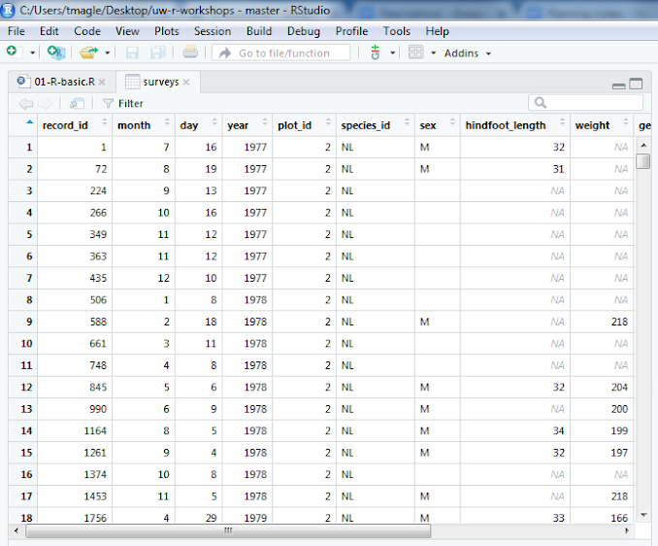
Data frames
Rows = observations
Columns = variables
All values in a column must be the same data type.
All columns must have same number of rows.
Notes:
To load this data table into R, we can use the read.csv() function
this function take a filename as input
And returns the table stored in a data frame as ouput
Demo 4:
Find csv file in the files pane
surveys <- read.csv('data/raw_surveys.csv')
Open the table and have a look

Slide 24
Let’s check out a data frame!
we will use “practice data” for now
we will learn to import “real data” later on in the quarter

Slide 25
Packages
Many of the most useful functions of R come from add-on packages.
Packages can include:
reusable functions
the documentation that describes how to use them
sample data
Some are well maintained, and others are not (user beware)

Slide 26
Packages Example
Think of packages as apps for your phone
Install it once, and “open” it when you want to use a package in your script
Important: you need to load the package each time you open RStudio
#run this once
install.packages("dslabs")
#run this every time you open RStudio
library(dslabs)

Slide 27
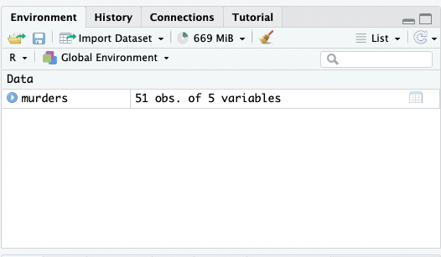
Let’s check out a data frame!
Load the dataset murders from the dslabs package:
library(dslabs)
data(murders)

Slide 28
Let’s check out a data frame!
You can already see some information about the data frame:
51 observations
5 variables

Slide 29
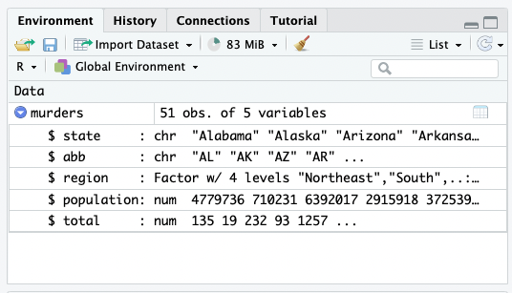
Let’s check out a data frame!
If you press the blue “play button” to the left of the name, you will get more detailed information on the variables

Slide 30
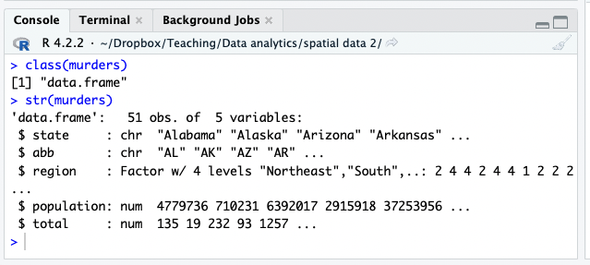
Let’s check out a data frame!
Same information gets sent to the console if you examine its structure with the str() function: str(murders)

Slide 31
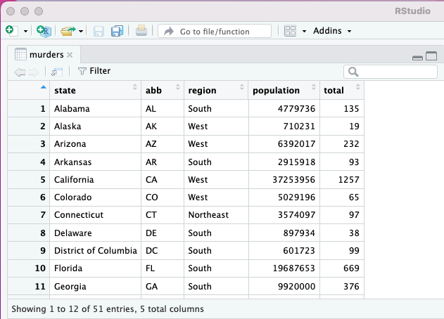
Let’s check out a data frame!
Click on the dataframe in your Environment pane to view the dataset in it’s entirety
You can also type:
view(murders)

Slide 32
Let’s check out a data frame!
The data viewer provides a helpful first look at your data (you should always visually inspect your data)
We can also apply some easy point and click tools to sort/filter in the viewer

Slide 33
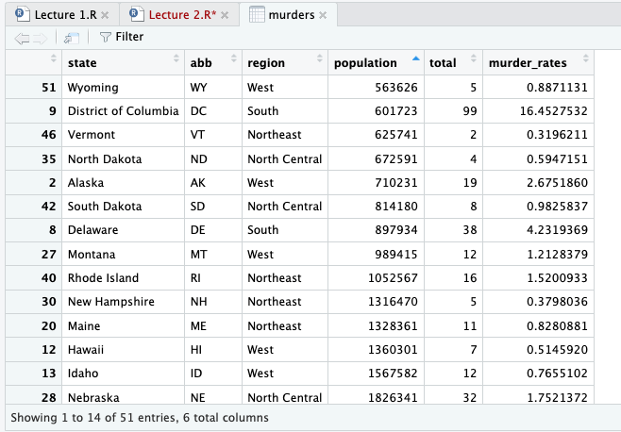
Sorting in the data viewer
you can sort by any column by just by clicking on the column
Click on a column that’s already sorted to reverse the sort direction

Slide 34
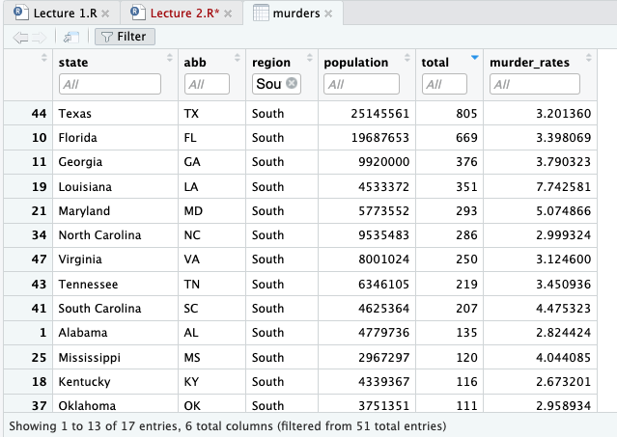
Filtering in the data viewer
To apply filters, click the Filter icon in the toolbar
Any field that can be filtered will have a white box labeled All
PollEv.com/vsovero

Slide 35
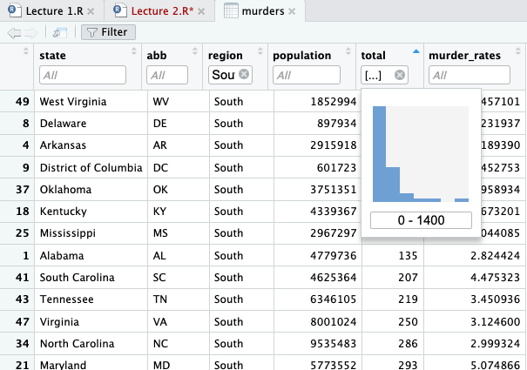
Filtering in the data viewer
If you click on a numeric variable, a histogram will pop up where you can select the values you want to filter for

Slide 36
Filtering in the data viewer
Filtering/sorting in the data viewer does not make any permanent changes to the murders data frame
For example, if you reopen the viewer after filtering for the South, all of the regions will still be there

Slide 37
Functions for Inspecting data frames
Function | Output
class* | Class of the object
str* | structure: # rows, cols, data types
head/tail* | look at first/last 6 rows (all columns)
nrow/ncol | number of rows/columns
names | column names
summary* | summary stats for each column (min, max, etc.)
* Also inspects vectors
Notes:
Slide 15: Now that the data table is loaded into a variable, we can inspect the data to see what’s there using the 6 functions on this slide.

Slide 38
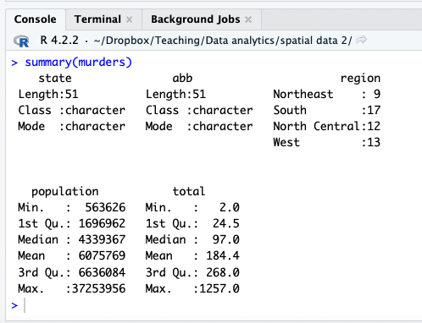
Summary Statistics
Display some summary statistics with summary() function:
summary(murders)

Slide 39
Summary Statistics (numeric)
summary stats for numeric vectors:
min, max
quartiles
mean

Slide 40
Summary Statistics (factor)
summary stats for factor variables:
levels (categories)
frequencies of each level

Slide 41
Summary Statistics (character)
summary stats for character vectors: not much to report
This is also why it’s better to store categorical data as a factor

Slide 42
Referencing Vectors in a Data Frame
We use the accessor operator $ to reference a vector in a data frame:
murders$population

Slide 43
Example: Check vector type in a data frame
You can use the accessor operator $ combined with class() to check the vector type of population
class(murders$population)

Slide 44
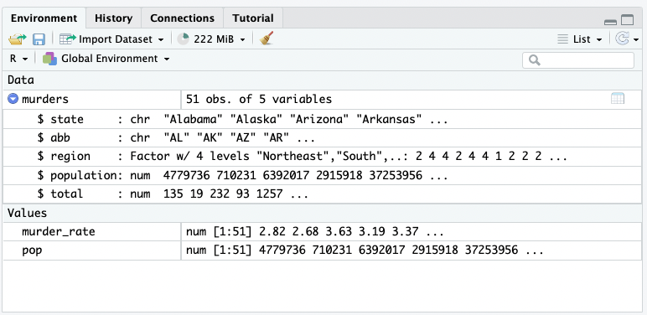
Creating new vectors with $
murder_rate <- murders $ total /murders $ population * 100000
we can create a new vector (murder_rate) by referencing vectors in the murders data frame

Slide 45
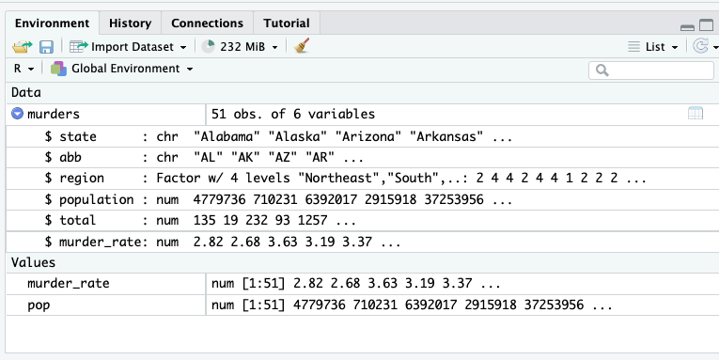
Adding a vector to a Data Frame with $
murders$murder_rate <- murders$total /murders$population*100000
It’s more useful to add the new vector to the murder data frame
PollEv.com/vsovero

